Slide 1
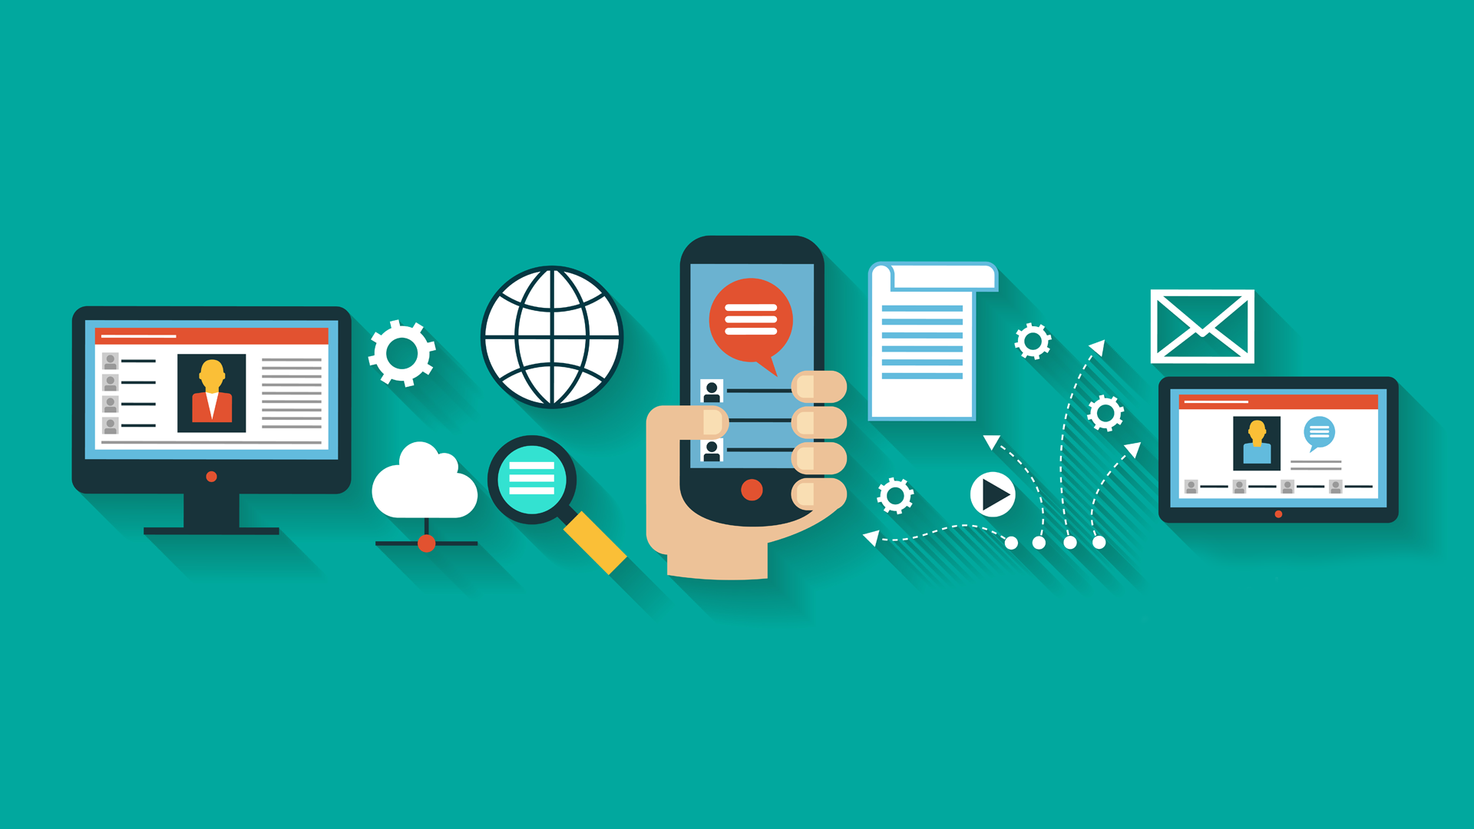
Mobile Marketing
Shijiao Chen, PhD Candidate, Marketing
Shijiao.chen@postgrad.otago.ac.nz

Slide 2
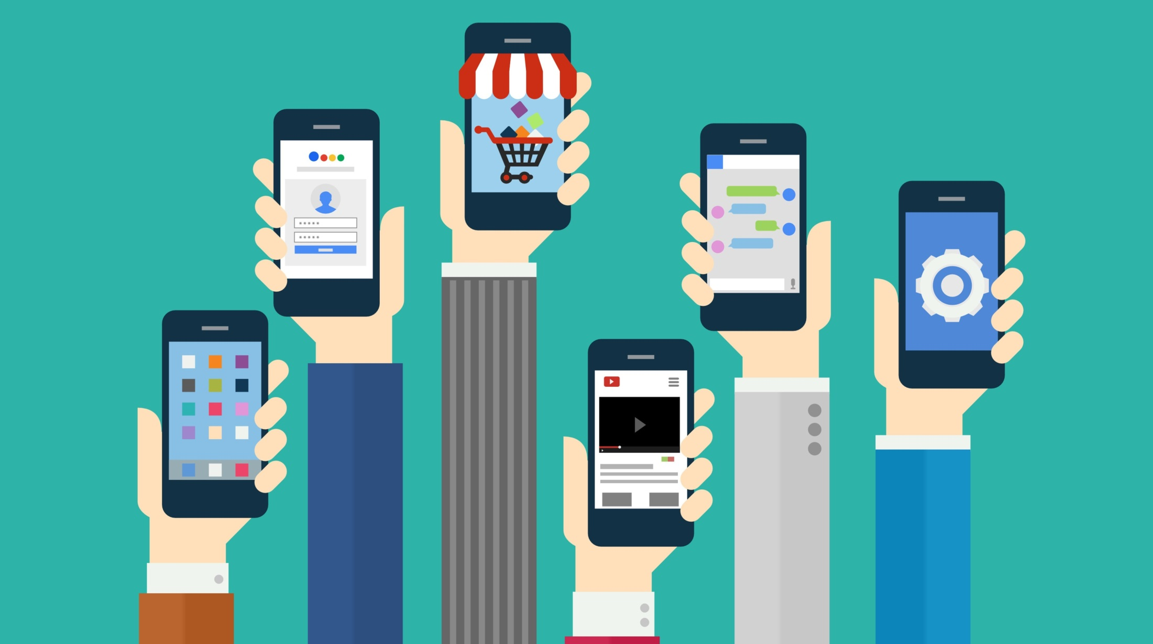
Why is mobile marketing important?
Notes:
How many of you can get access to the Internet through your mobile?
Share some stories about your mobile usage. What do you use your mobile for? How many times do you check your mobile everyday? When? How many hours?

Slide 3
NZ mobile users
70% of New Zealanders own a mobile connected device.
In an average week, 3.1 million New Zealanders aged +15 spend 14 hours online.

Slide 4
Usage situation
90% of New Zealanders use social media, and three quarters use Facebook on a monthly basis.
Desktop/laptops are still the most dominant device used for this activity, however mobile and the use of apps is increasingly prevalent – over half of Facebook visitors each month access via a smartphone app, and more than two in five for Twitter.

Slide 5
Usage situation
Access weather information and news updates.
Short-form video clips.
Research products and services, and listen to music or digital radio.

Slide 6
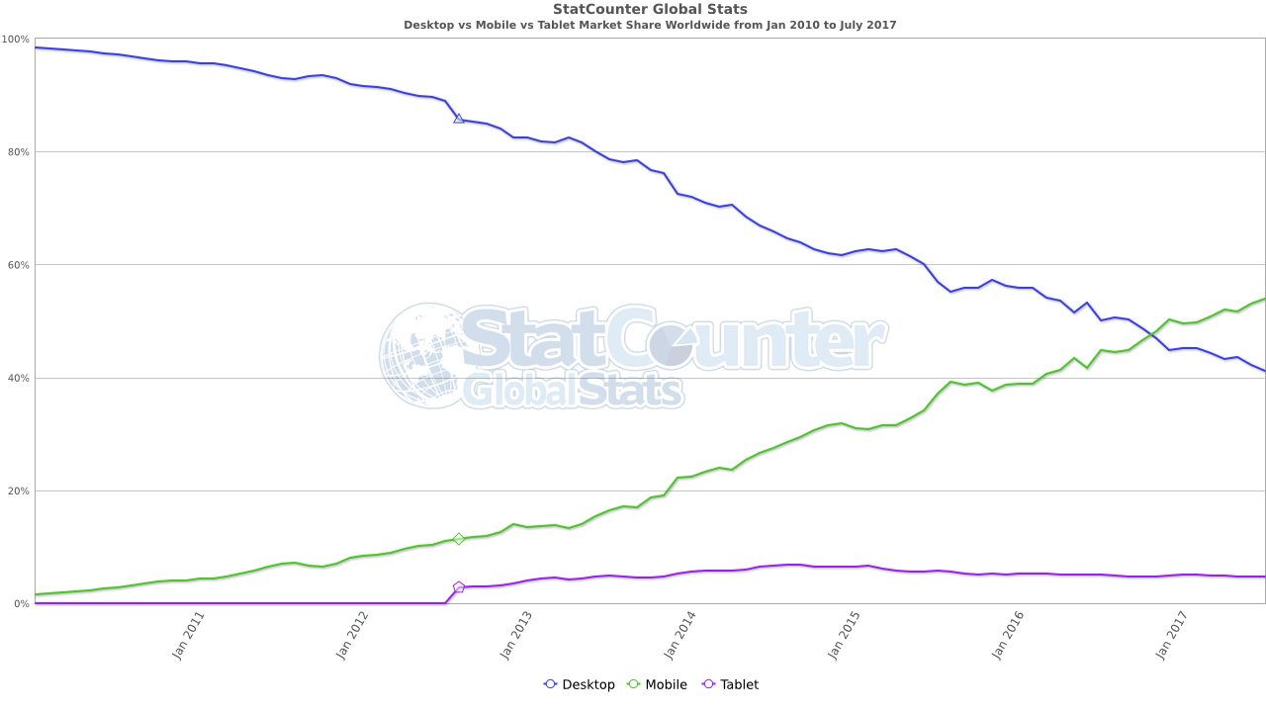
More users
Notes:
Global market share

Slide 7
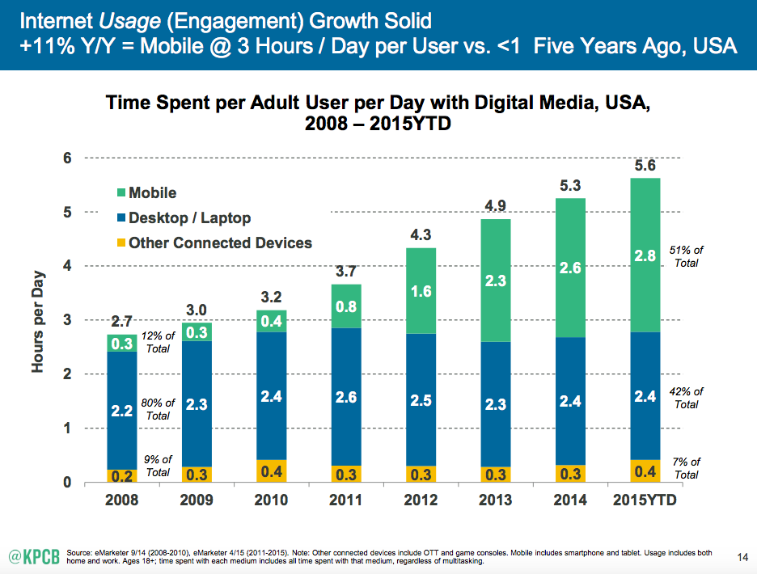
Spend more time
Notes:
People spend more and more time in mobile. Account 51% of their daily digital spending time

Slide 8
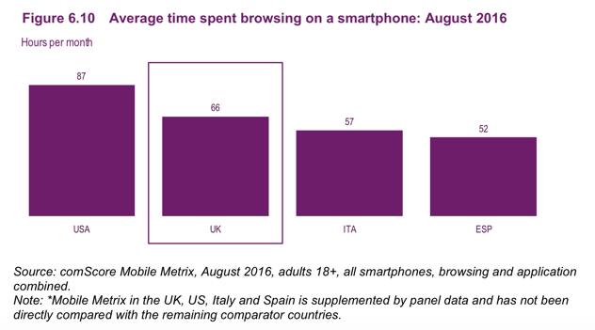

Slide 9
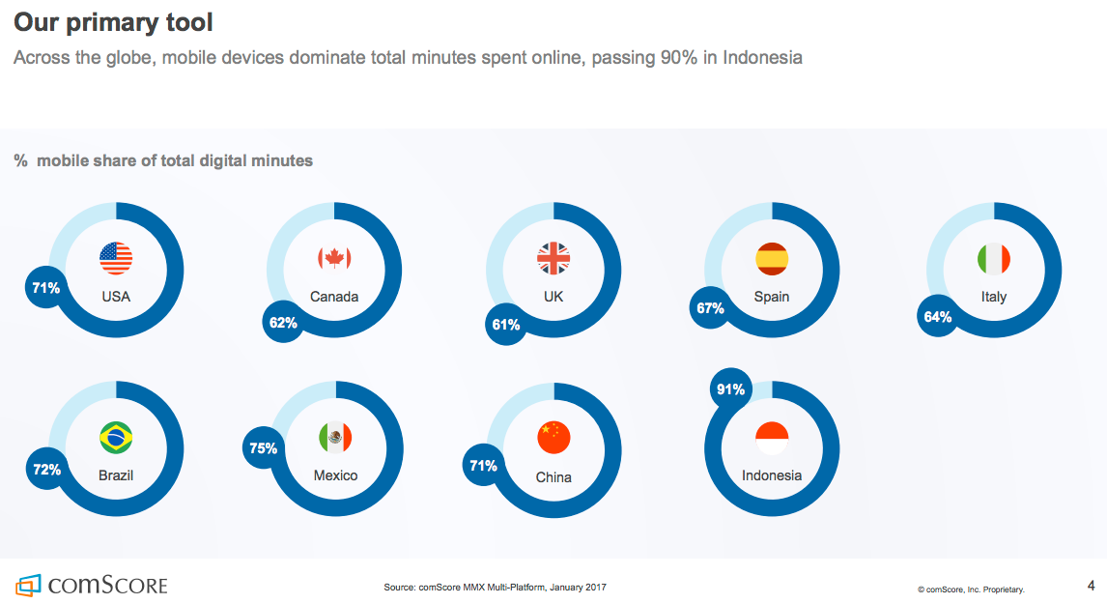

Slide 10
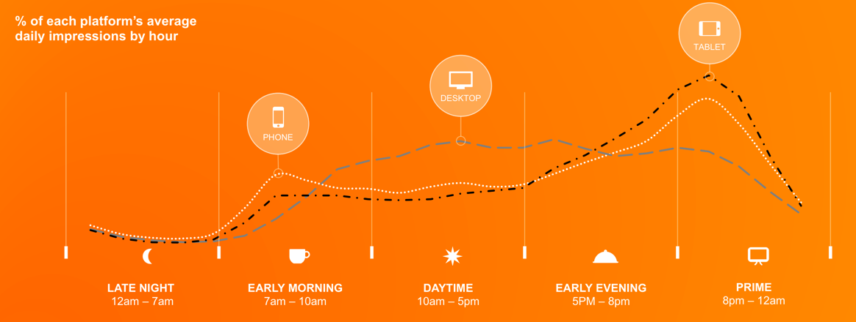
Daily usage
Mobile media use varies through the day. This is important to understand for dayparting. Desktop is still important for daytime at work audiences, but Tablet and smartphone dominate in the evening.
Notes:
Mobile: morning and evening
Desktop: daytime

Slide 11
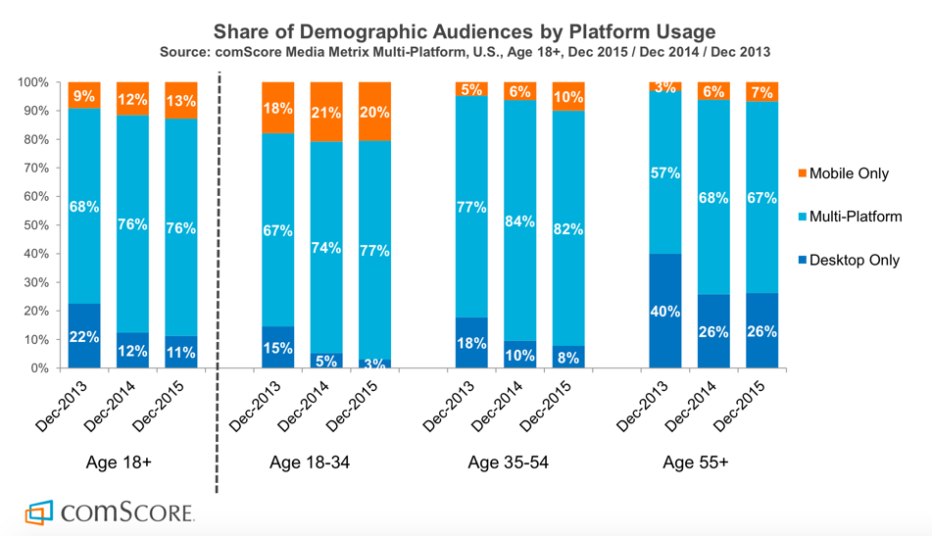
Notes:
For people aged 18-34, more and more of them only use mobile
For people aged over 55, there is still a large proportion of people only use desktop

Slide 12
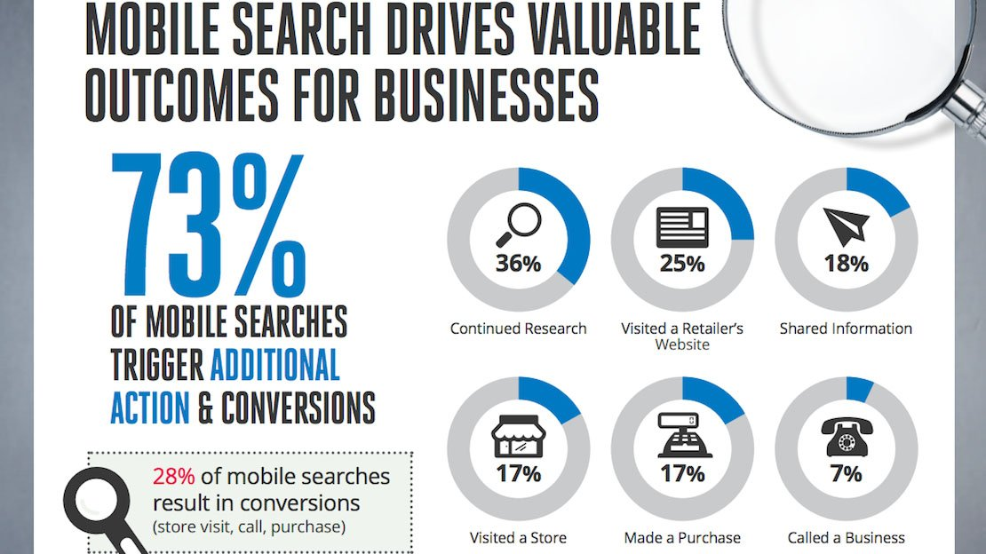

Slide 14
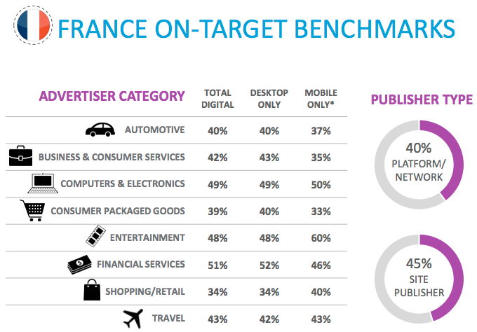

Slide 15
Most popular smartphone apps
Rank | Name | Owner
1 | Facebook | Facebook
2 | Facebook Messenger | Facebook
3 | YouTube | Google
4 | Google Maps | Google
5 | Google Search | Google
6 | Google Play | Google
7 | Gmail | Google
8 | Instagram | Facebook
9 | Apple Music | Apple
10 | Amazon App | Amazon
Top Free iPhone Apps Snapchat Messenger Pokémon GO Instagram Facebook YouTube Google Maps Pandora Netflix Spotify Music

Slide 16
Mobile vs. desktop
Technical constraints
Smaller screens
Difficult to read. Certain website features may not fit on the scree. Content proportion.
Difficult clicking
Fingertips vs. mouse icons
Difficult typing
Slow loading
Less data intensive than the full site

Slide 17
Mobile vs. desktop
Technical advantages
GPS
Contact advantage
Check frequently
Customer stickiness-the increased chance to utilize the same product or service that was bought in the last time period.

Slide 18
Mobile vs. desktop
1 Mobile users activity usually peaks during morning and evenings
Understanding how users divide their time across devices is a critical point in optimizing your mobile strategy.
2 Consider the different nature of objectives when browsing
Mobile users are generally on the hunt for specific information, while time consuming activities are usually reserved for the comfort of PCs.
3 Content is the king.
Mobile users scan rather than digest content. A lower attention span is specific to mobile users, who prefer situation-related and leisure-themed content.

Slide 19
Mobile vs. desktop
4 Desktop users still earning top engagement numbers.
Desktop visits last 3 times longer on average than mobile visits, with more pages viewed and half the bounce rate.
5 What users are looking for is different.
Mobile visitors on a certain website tend to be more utilitarian (time, specific goal).
6 Pre-purchase research
Nearly half of the users rely exclusively on their mobile devices for pre-purchase research, and that 30% of smartphone users and 25% of tablet users have immediate needs and purchase within an hour.
7 Purchase behaviours.
People still prefer making small-budget impulse purchases from their mobile, such as tickets, gift cards, food, and electronics.

Slide 20
Understand users
Demographic characteristics
Location
Age
Income
Gender
Family status

Slide 21
Understand users
Psychological characteristics
Purchase intention
Search
In-store browsing
Urgency
Recommendations

Slide 22
Understand users
Usage situations
Banking
Shopping
Travelling
Food and drinks
Living and housing
others

Slide 23
Create user journey
B2B
Doing numerous research for suppliers
Reading online reviews of these suppliers
Signing up for newsletters from each of these suppliers
Asking opinions from social network of their experiences

Slide 24
Create user journey
B2C (Arline)
Looking at destinations, exploring holiday options and looking at the suitability for different types of travel
Understand when flights are available
The process of using the points to book flights

Slide 25
Create user journey
Case study
Yelp
AirNZ
https://www.youtube.com/watch?v=kqwhVtGdjDI&list=LLlzEFgEHapCQiNfS05UoyRw&index=22
Booking.com
https://www.youtube.com/watch?v=eDeCWwvTvb8&list=LLlzEFgEHapCQiNfS05UoyRw&index=23
ANZ

Slide 26
Tools
QR Code
Quick Response codes allow you to scan a square code using your mobile device, which can then trigger some behaviours within your mobile.
Notes:
Q: did you ever use QR code? In what occasions?

Slide 27
QR code-product traceability

Slide 28
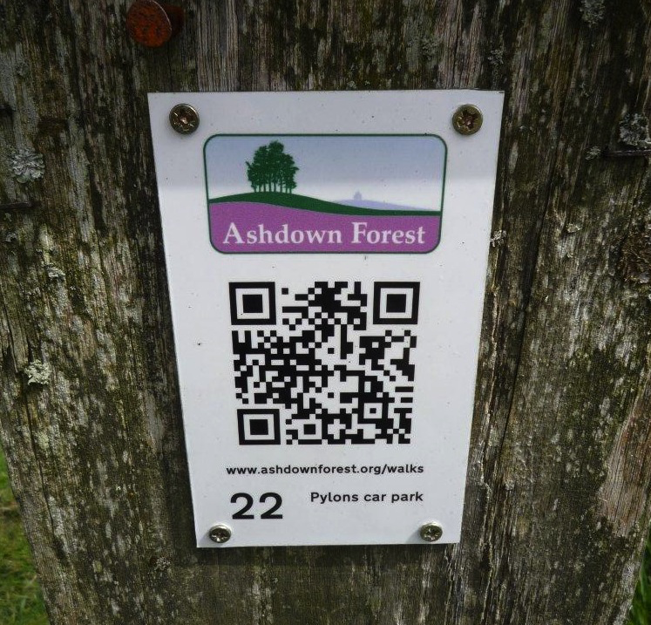
QR code-Getting detailed information

Slide 29
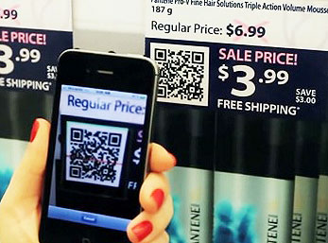
QR code-promotion

Slide 30
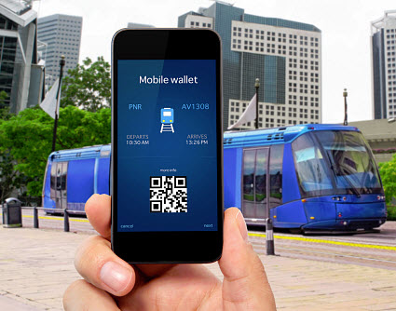
QR code-ticket

Slide 31
QR code-transaction

Slide 32
Tools
Coupon
A mobile coupon is an electronic ticket solicited and or delivered to a mobile phone that can be exchanged for financial discount or rebate when purchasing product or service.
A mobile app coupon can be either a regular coupon for redemption (discount value or discount percentage) used at checkout distributed by the app-makers or unique, personal sharing codes owned by each user to recruit new users with referral benefits (e.g. Airbnb, Uber). The latter form requires personal sharing on behalf of users to their personal networks.
https://www.youtube.com/watch?v=W3IRokf20HY&list=LLlzEFgEHapCQiNfS05UoyRw&index=21

Slide 33
Tools
Mobile payment and cashier-less smart store
https://www.youtube.com/watch?v=NrmMk1Myrxc&index=19&list=LLlzEFgEHapCQiNfS05UoyRw
https://www.youtube.com/watch?v=yQ0xEEFiWWQ

Slide 34
Mobile design principle
Prioritization of content
Horizontal vs vertical layout
Links and buttons
Screen size graphics
Reduced hierarchy
Phone integration

Slide 35
Discussion
8~10 students in a group
8 minutes discussion
2~3 minute presentation

Slide 36
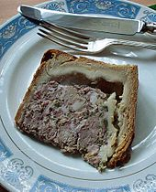
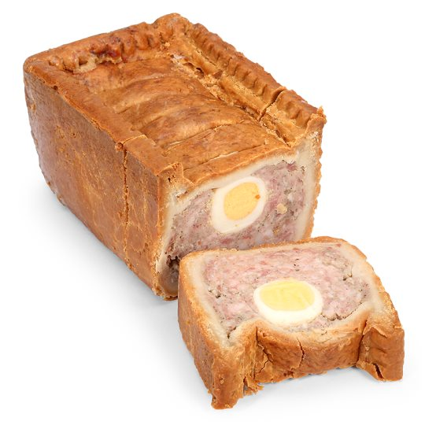
Pork Pie
Standard individual pork pie
Pork pie slice
Gala pie
Robust
Not messy to carry around and eat
No need for reheating
Amenable to mass manufacture
Stable in transit and display

Slide 37
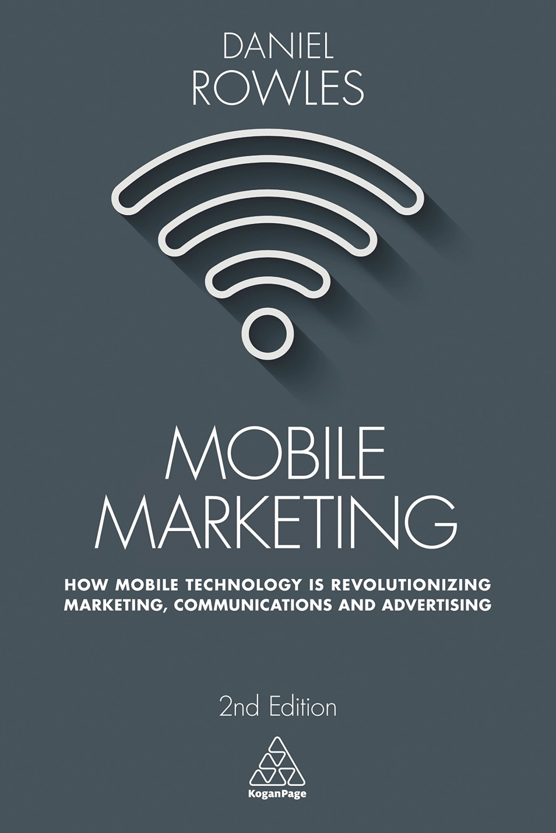
Very useful and a surprisingly compelling read. It articulates the theories and terminology of mobile marketing succinctly, with interesting graphs and case studies from around the world.
Shijiao Chen, Marketing Department
Shijiao.chen@postgrad.otago.ac.nz

