Slide 1
Digital marketing
Brooke lowry
Marketing manager – Digital
commonwealth bank of australia

Slide 2
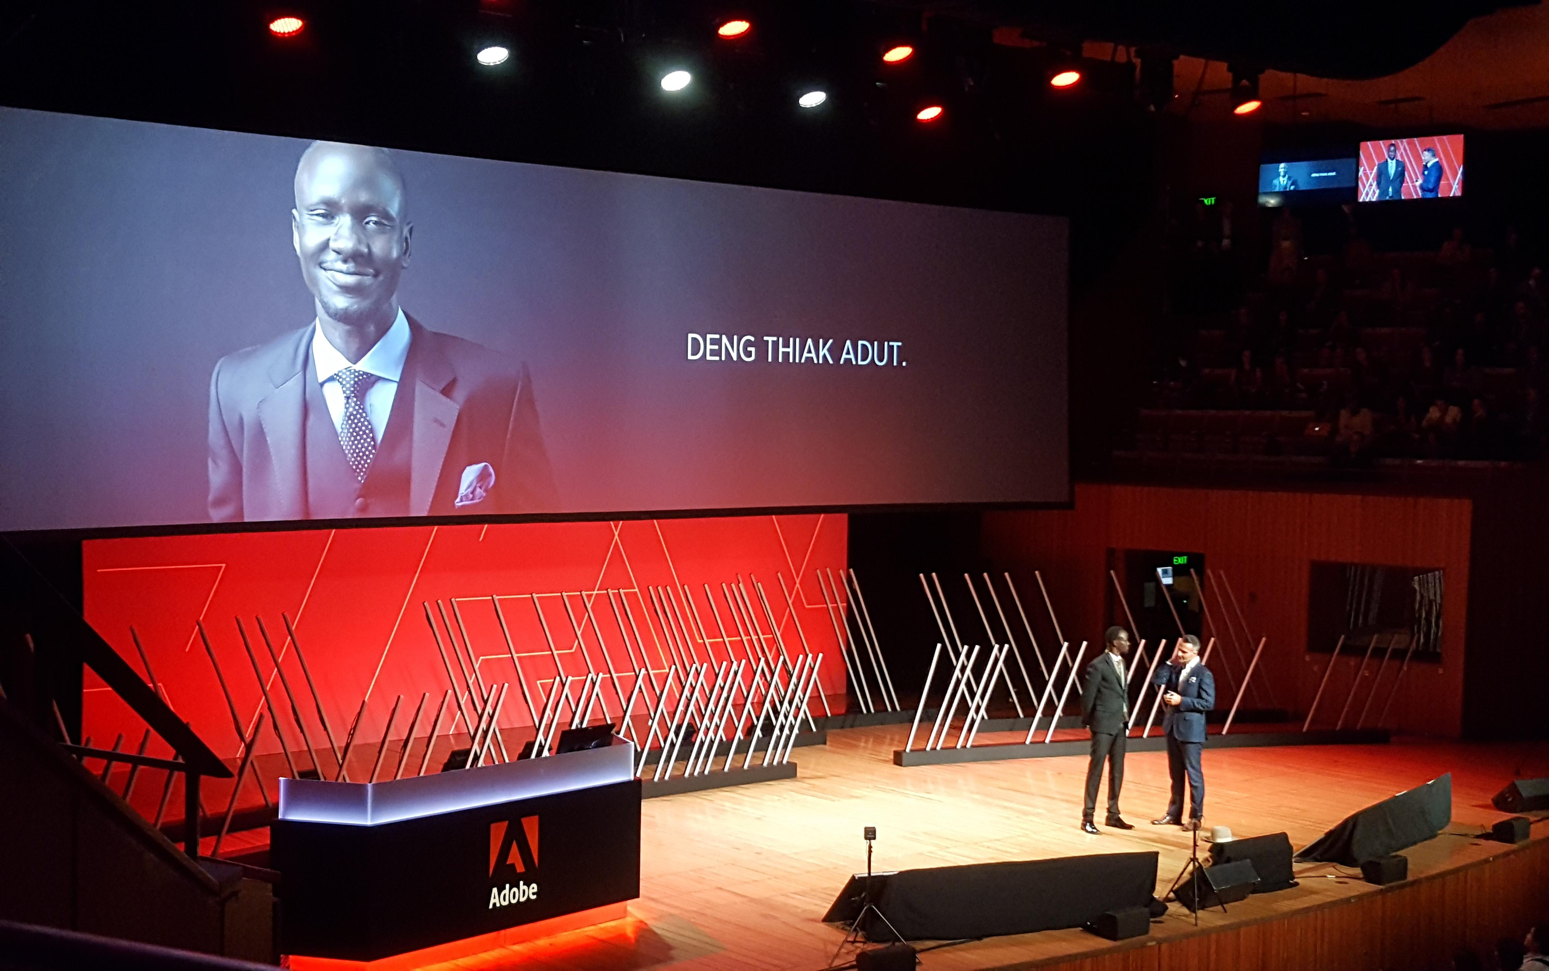
Adobe symposium

Slide 3
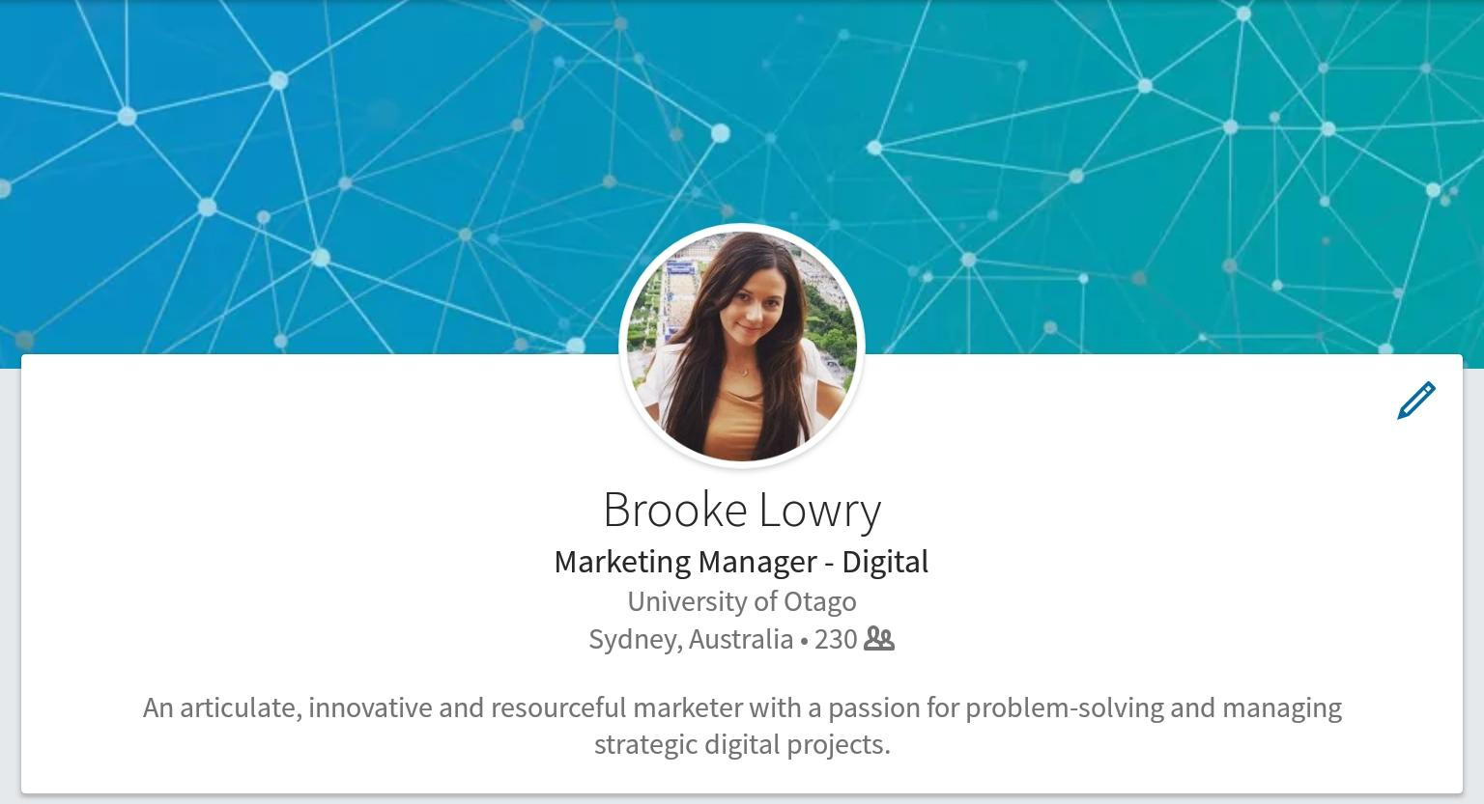
Life after grad

Slide 4
A brief history
Publicist (Dunedin Fringe Festival)
Marketing Coordinator (Delta)
Digital Marketing Executive (Auckland Regional Public Health Service)
Digital Marketing Consultant (Matt Blatt)
Marketing Manager – Digital (Commonwealth Bank of Australia)

Slide 5
DIGITAL MARKETING
Social media
Website development
App development
Email marketing
Business improvement
Change management

Slide 6
You’re in the right place if…
You’re always thinking about the future
You’re passionate about growth, innovation and development
You think things can be done better
You want to design better processes for people
You like efficiency and productivity

Slide 7
Learning and innovation
“Learning and innovation go hand in hand. The arrogance of success is to think that what you did yesterday will be sufficient for tomorrow.”
- WILLIAM POLLARD

Slide 8
Innovation and competitive advantage
Why do companies want to hire you?
Innovation isn’t about coming up with good ideas…
Its about facilitating the process for generating insights and creating new products and services
Innovation is about research, speaking to customers and analysing data

Slide 9
Barriers to innovation
Ignoring your customers
Too much of a focus on business requirements and documentation
Top-down project management
Vague delivery dates, lack of support from management
How can businesses improve the innovation process?

Slide 10
Design thinking

Slide 11
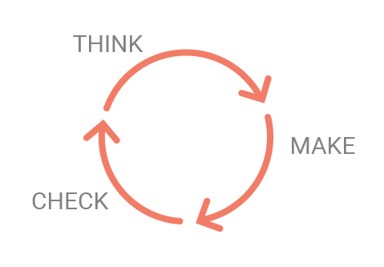
Ux/Lean ux

Slide 12
Agile process

Slide 13
Agile scrum team

Slide 14
Agile methodology

Slide 15
Product owner
Represents the Business Owner
Chairs the Business Working Group
Prioritises scrum team’s workload
Manages delivery requirements with the Scrum Master
Responsible for the quality of the product
Responsible for the delivery of the product
Maintains a customer focus throughout the project
Communicates scope change with business

Slide 16
Managing stakeholders
Executive Leadership Team
Business Working Group
Product Owners
Agile Scrum Team
Delivery Owner
Business Owner
Executive Scrum
Service Delivery Manager

Slide 17
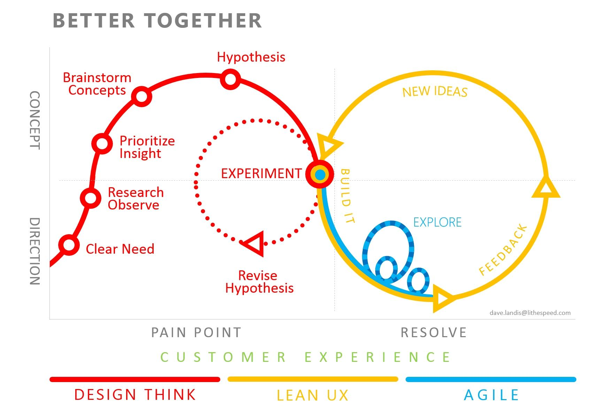
CUSTOMER EXPERIENCE
Design-thinking
Lean UX
Agile

Slide 18
The future of marketing
Digital marketing + User experience design
+ Agile mindset

Slide 19
Tips for success
Take on roles that give you exposure
The majority of my time is spent influencing people
When you work in digital, you are a champion of change
Resolve problems with people face-to-face
When you work in a team, stick to your role and do it well

Slide 20
Key Skills for grads
Influencing skills and stakeholder engagement
Marketing strategy
Project/product management
Customer-centered design/UX design
Digital marketing/knowledge of technologies

Slide 21
Digital marketing toolkit

Slide 22
Thank you

