Slide 1
Integrated Digital Marketing
Chris Dzikiewicz

Slide 2
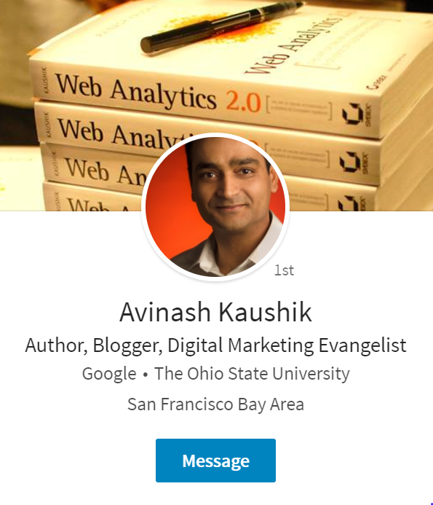
SEE – THINK – DO - CARE
www.kaushik.net

Slide 3
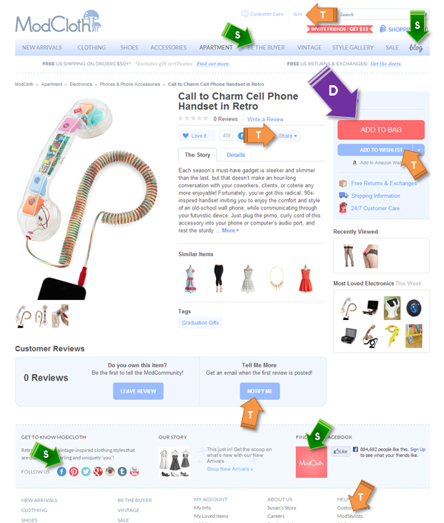
www.kaushik.net

Slide 4
Spa pool brand

Slide 5
online
offline

Slide 6
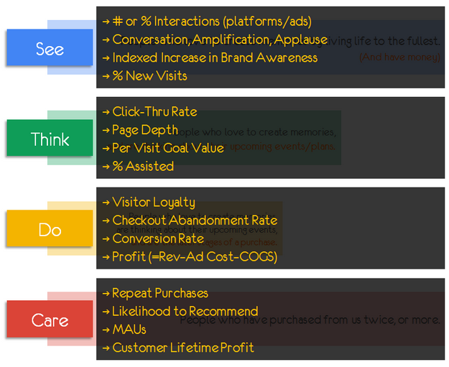
www.kaushik.net

Slide 7
Other thoughts
Investment in Digital Presence: NZ is behing the rest of the world
Things change quickly – Keep Learning & be a Strategist
Not only Facebook & Google

Slide 8
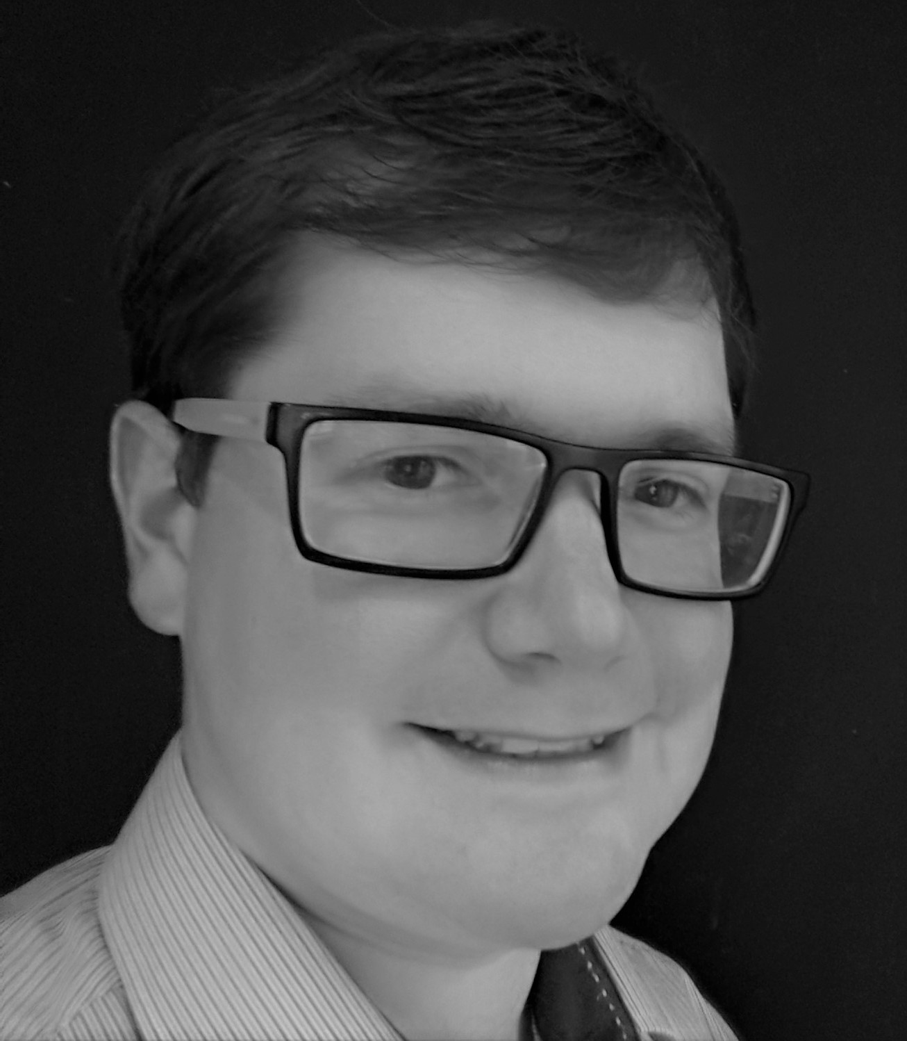
Chris Dzikiewicz 027 216 5297 chris@digitalwiseman.com
Thank you. Get in touch

